Slide 1
Investigating Defects in REBCO Using DFT and Machine Learning Potentials
Supervisors: Rebecca Nicholls & Jonathan Yates

Slide 2
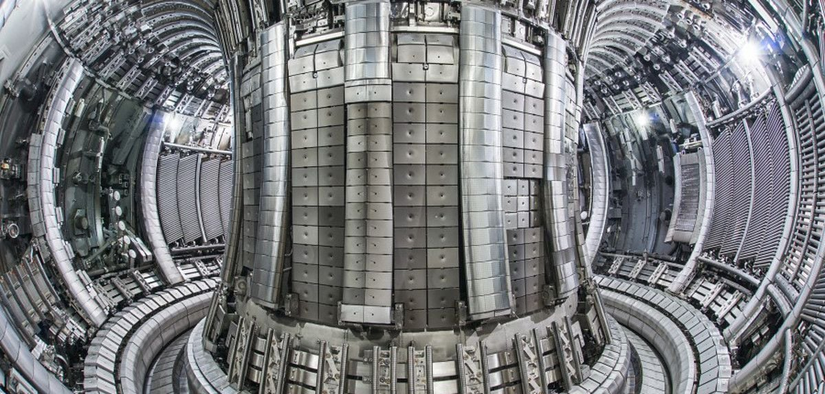
Background
High magnetic fields in fusion magnets rely on REBCO superconductors
2 / 17
Notes:
High-temperature superconductors like REBCO are very important for next-generation fusion reactors, because they can generate the extremely strong magnetic fields needed to confine plasma.
The reactor will generate neutrons, but these neutrons will also damage the material in magnets and other materials in reactor, and REBCO is very sensitive to the damage.

Slide 3
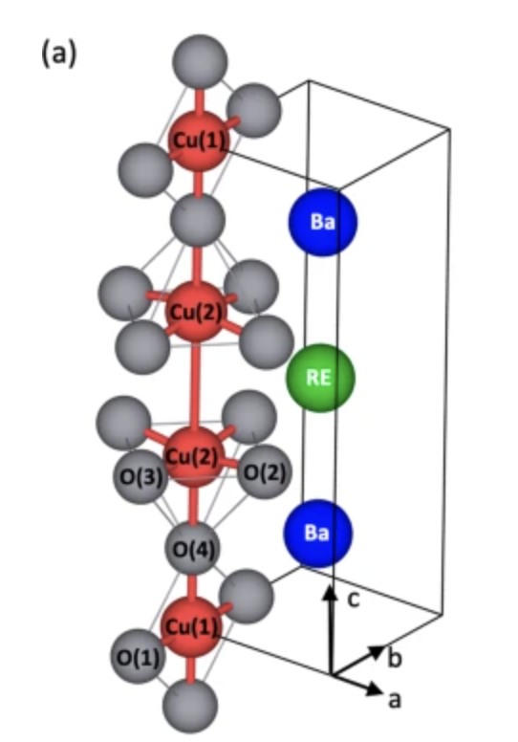
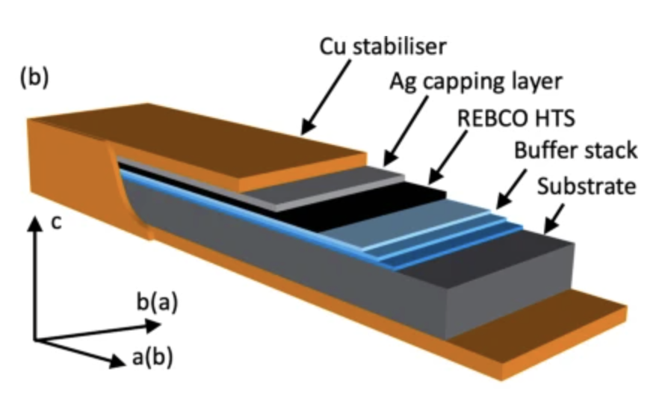
Background
Part of the REBCO unit cell showing the two different Cu sites (in red) and their coordination with O atoms (in grey).
Schematic diagram of a generic coated conductor tape
3 / 17
Notes:
Only need about 4 displacement per 1000 atoms in REBCO to drop critical temperature 10% down. Which means there are many defects in the irradiated REBCO, and the irradiated REBCO no longer have superconductivity. Previous research have pointed out the defect type in irradiated REBCO , mainly O vacancy in Cu O plane, O interstitial, and Frankel defects, and how these defects affect the superconductivity of the material.
However, most of these studies are based on static observations, such as using microscopy to observe irradiated REBCO. We are also interested in the dynamic behaviour of these defects, for example how defects interact after they are formed, and whether vacancies and interstitials influence each other.

Slide 4
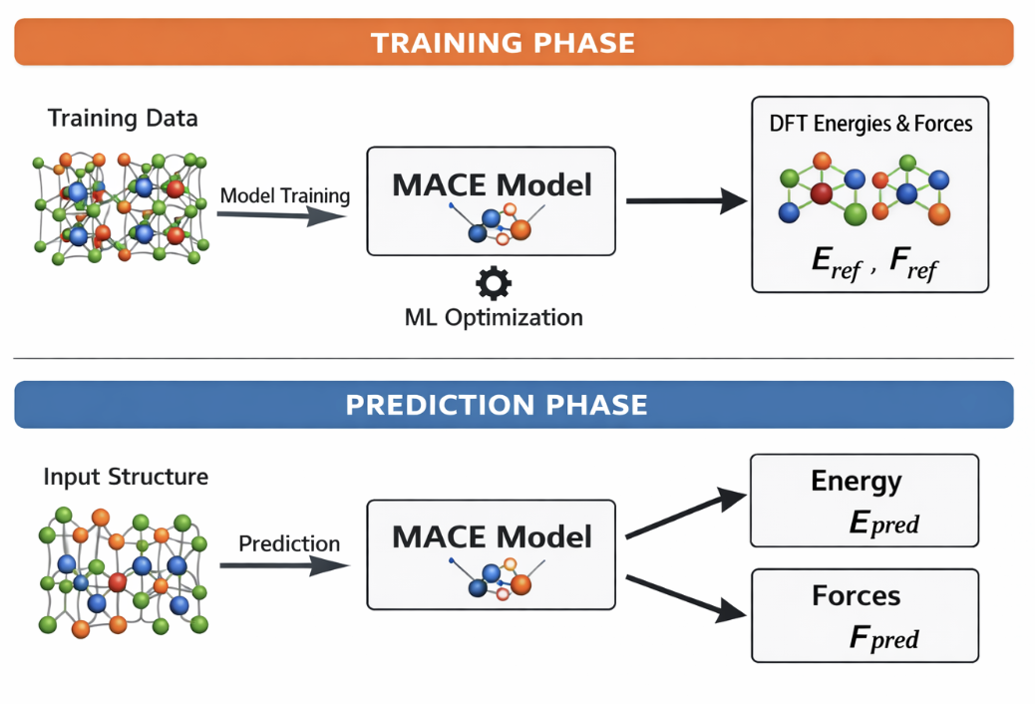
Machine learning potential
4 / 17
Notes:
Therefore, we want to study REBCO using molecular dynamics (MD) in order to understand the behaviour of irradiation-induced defects at the atomic scale.
However, although traditional DFT-based MD is highly accurate, it is also computationally very expensive. For a complex system like REBCO, especially when a large supercell is needed to model defects, the simulation becomes far too slow.
By using ASE, it is much easier to run MD simulations However, due to the complicated structure, conventional empirical potentials have limitations like Chaplot potential, it was developed for more ideal and regular crystal environments. In particular, after irradiation, REBCO shows significant extension along the c axis, and these traditional potentials often struggle to describe such large deformation. So ,we choose MACE. MACE is a machine learning potential, doesnt have an analytic expression, it works more like a black box, you give it a structure as input, it returns energy and forces. However, MACE is trained on conventional materials and regular crystals, Irradiated REBCO is much more complicated, we are not sure MACE is accurate or not.

Slide 5
Validation strategy
Compare DFT and ASE + MACE for geometry optimisation.
Test both pristine and defective structures: interstitial, vacancy, and Frenkel defect.
Use bond length as the main structural metric, because it is sensitive to local distortion around defects.
5 / 17
Notes:
So, the first task of my project is to validate the accuracy of MACE. I first performed geometry optimisation in DFT for both pristine REBCO and defective structures containing interstitials, vacancies, and Frenkel defects, in order to obtain a set benchmark data.
For the DFT calculations, I used the PBE functional, because the MACE was also trained on PBE DFT data.
I then used MACE within ASE to perform geometry optimisation on the same structures, and compared the resulting structural data with the DFT results. The main quantity I focused on was bond length, because it directly reflects the local atomic environment and is very sensitive to structural distortion near defects.

Slide 6
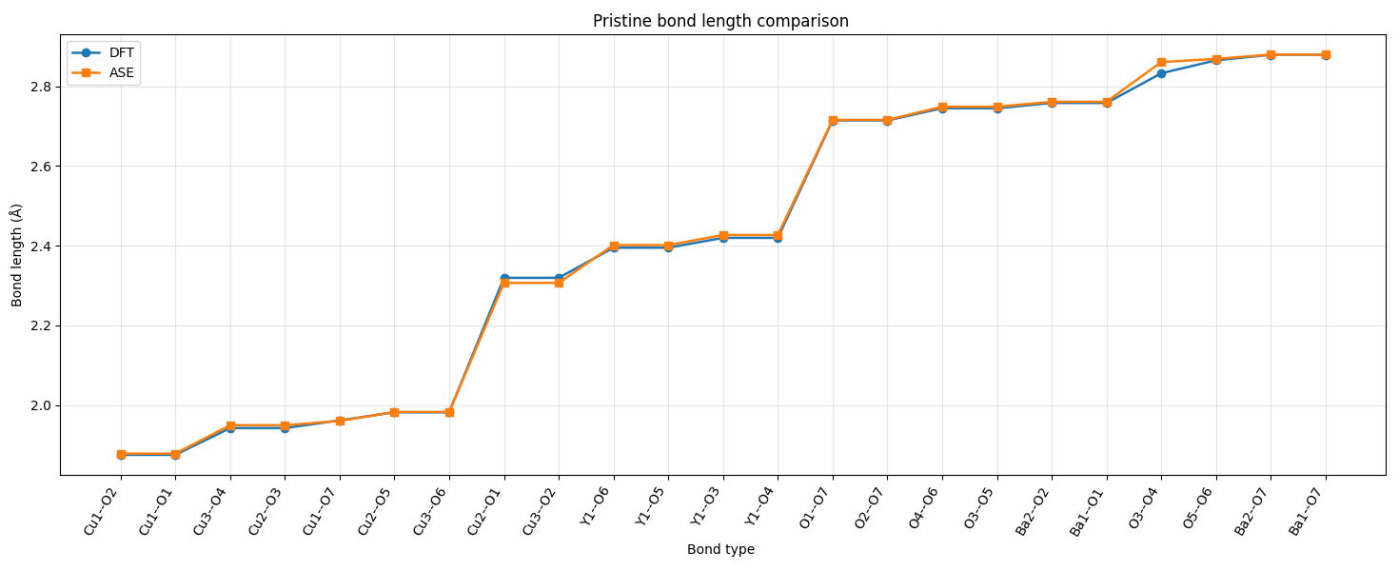
DFT vs MACE
6 / 17
Notes:
This figure shows the comparison of bond lengths between MACE and DFT for pristine Rebco
The orange line corresponds to MACE, and the blue line corresponds to DFT.
On the x-axis, I list different bond types, and on the y-axis is the bond length in angstrom.
As we can see, the two sets of data are in very close agreement across almost all bond types.

Slide 7
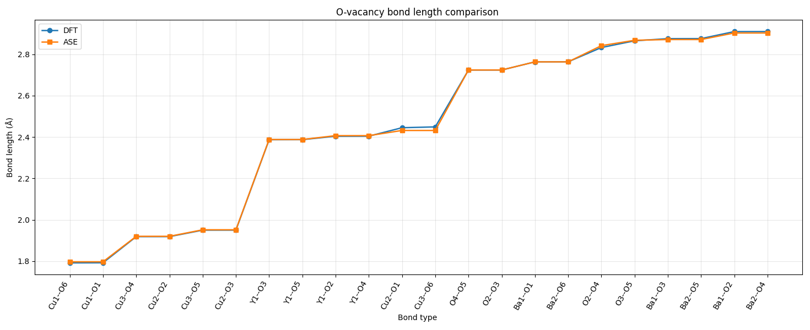
DFT vs MACE
7 / 17
Notes:
This figure shows the comparison of bond lengths between MACE and DFT for Oxygen vacancy defect.
The data sets are also very close.
This suggests that MACE can reproduce the local structure of REBCO very well,So this gives confidence that MACE is a reliable tool for modelling Rebco

Slide 8
MD set up
Target: stability of defects in irradiated REBCO
NVT ensemble at 298 K
Langevin thermostat for temperature control
Fixed-volume simulation of thermal equilibrium
5×5×3 supercell
8 / 17
Notes:
Since MACE shows very good agreement with DFT in terms of geometry-optimised bond lengths, I then used it for molecular dynamics simulations.
My research focuses on the stability of defects in irradiated REBCO.
After irradiation, the material loses its superconductivity and would be removed from the fusion reactor. So in the simulation, I used the NVT ensemble, where the number of particles, volume, and temperature are kept constant, with the temperature set to room temperature (298 K).
For temperature control, I used the Langevin thermostat.
This method maintains the system temperature by adding both damping and random forces to the equations of motion, while also mimicking the energy exchange between the lattice and a thermal bath.
For the structural model, I used a 5×5×3 REBCO supercell.
which provides a more realistic representation of low-concentration irradiation defects.

Slide 9
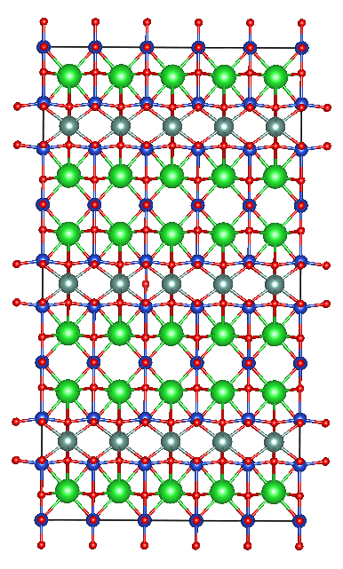
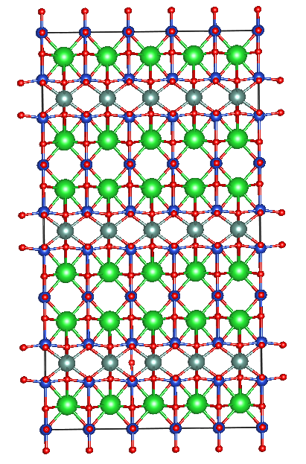
Frankel defects
Case 1: Oxygen Vacancy and Interstitial in same unit cell
Case 2:
Oxygen Vacancy and Interstitial in different unit cell
9 / 17

Slide 10
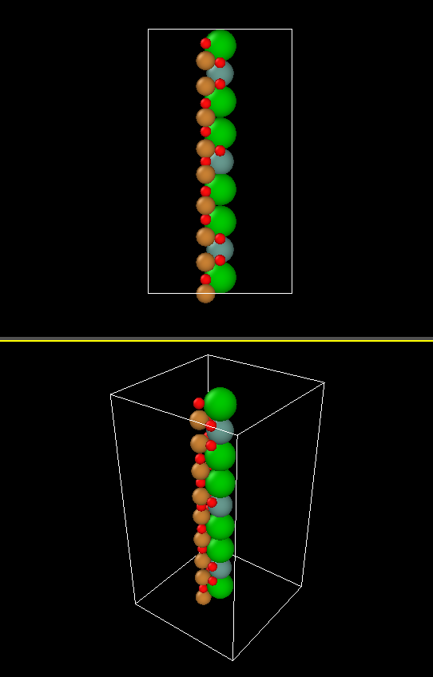
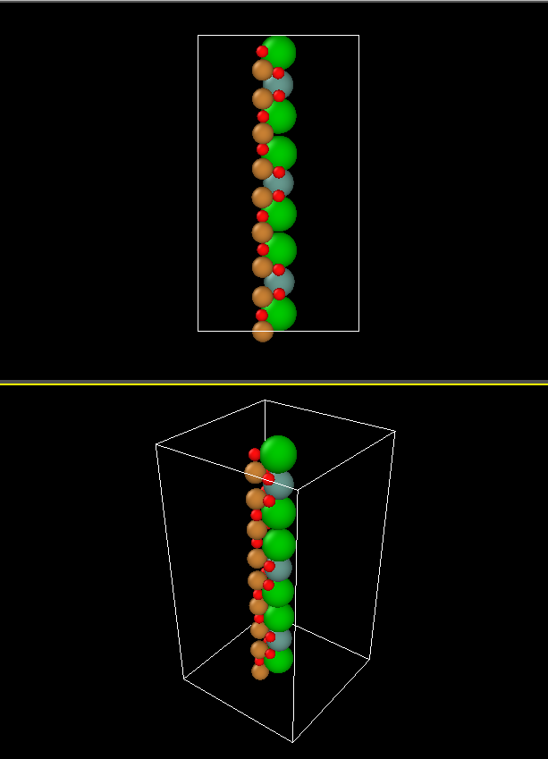
Case 1
10 / 17

Slide 11
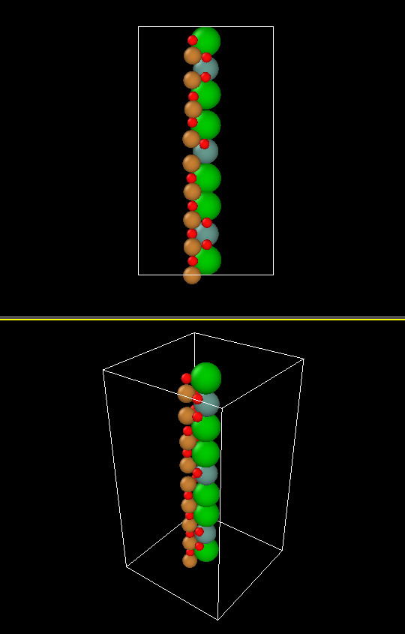
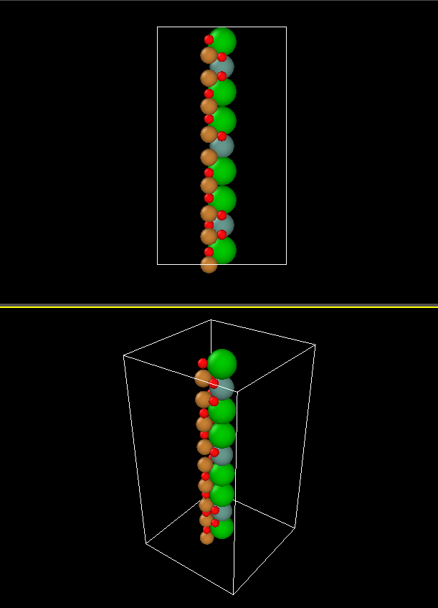
Case 2
11 / 17
Notes:
From the MD simulations we observe two different behaviours depending on the defect configuration.
In Case 1 the interstitial oxygen recombines with the vacancy during the simulation, while in Case 2 the Frenkel defect remains stable.
Beyond simply observing whether recombination occurs, we are also interested in how these defects influence the lattice dynamics of the material, including defect vibration, bond stiffness, disorder ect.
To analyse these effects, we calculate the velocity autocorrelation function (VACF) from the MD trajectories and obtain the vibrational density of states (VDOS) through Fourier transform.

Slide 12

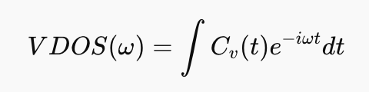
VACF & Vdos
Velocity autocorrelation function
Definition: Measures how atomic velocity correlates with itself over time, describes atomic vibrational dynamics
Vibrational density od state
Obtained from Fourier Transform of VACF
Definition; Represent the distribution of vibrational frequencies in the system
12 / 17
Notes:
a little bit equations for VDOS and VACF.
The velocity autocorrelation function, or VACF, measures how the velocity of atoms correlates with itself over time.
Mathematically, it is defined as the average dot product between the velocity at time zero and the velocity at a later time.
Physically, VACF describes how atomic motion evolves in time and therefore reflects the vibrational dynamics of the system.
From the VACF, we can obtain the vibrational density of states by performing a Fourier transform.

Slide 13
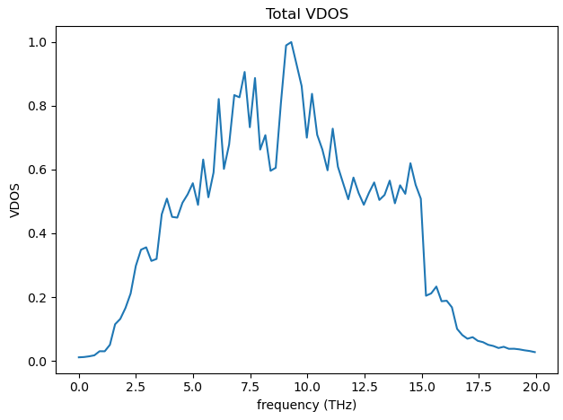
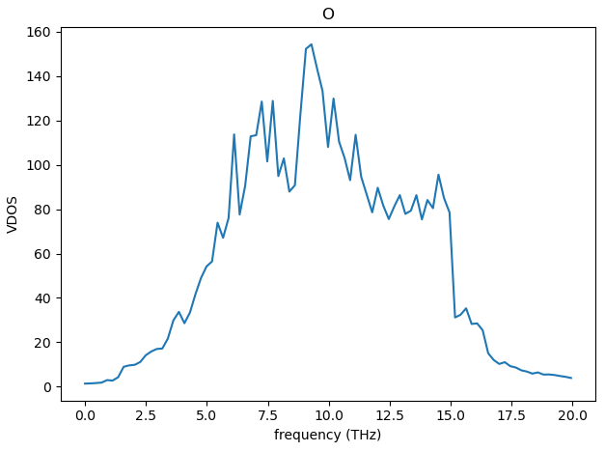
Vdos for case 2
13 / 17
Notes:
During the MD simulation, the vacancy and interstitial remain separated, and the overall lattice structure remains relatively stable.
First, looking at the total VDOS, the main vibrational intensity is between approximately 5 and 10 THz, with the strongest peak around 8 to 9 THz.
Next, we examine the element-resolved VDOS.
For oxygen, the spectrum closely follows the total VDOS, indicating that oxygen atoms dominate the vibrational behaviour of the system.

Slide 14
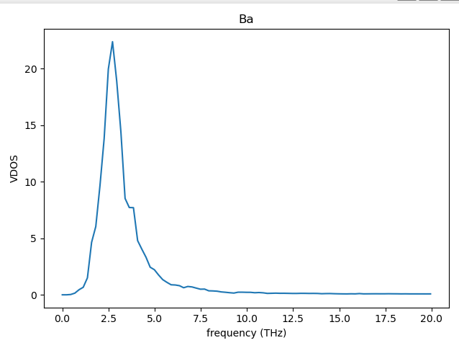
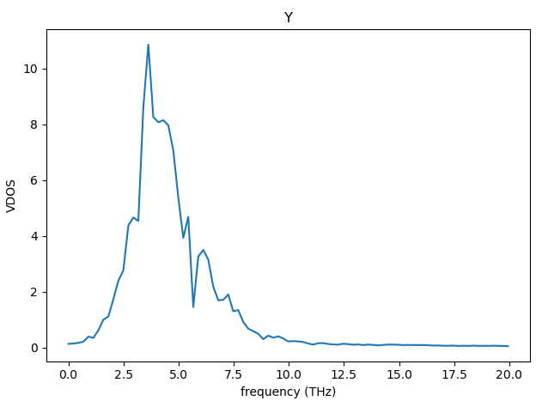
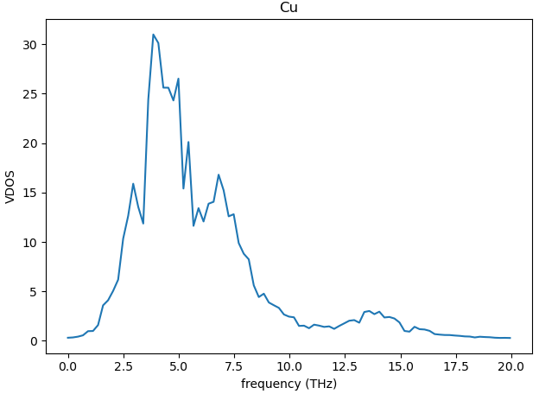
Vdos for case 2
14 / 17
Notes:
For barium and yttrium, the peaks are mainly located in the low-frequency region, around 3 to 5 THz. This is dur to their larger atomic masses, which lead to lower vibrational frequencies.
For copper, the main contribution appears in the intermediate frequency range, roughly between 4 and 8 THz, with a small contribution extending into higher frequencies.
Overall, the absence of any sharp abnormal peaks suggests that the Frenkel defect does not introduce strong lattice instability in this configuration, although it still perturbs the local vibrational environment.

Slide 15
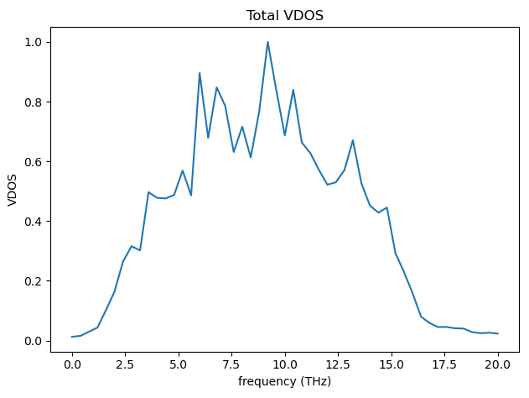
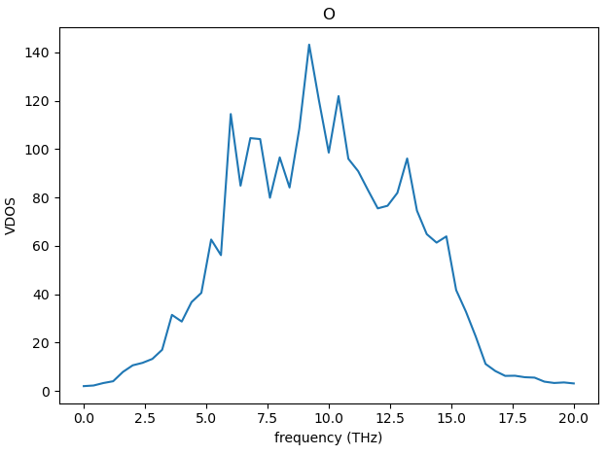
Vdos for case 1
15 / 17

Slide 16
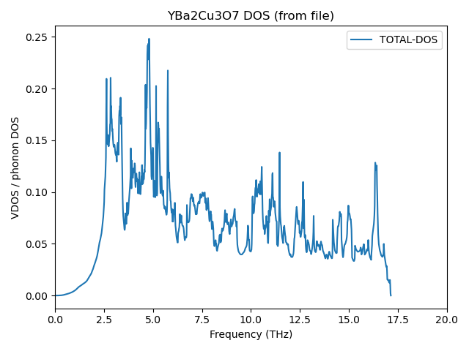
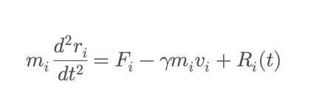
Perturbation graph
16 / 17

Slide 17
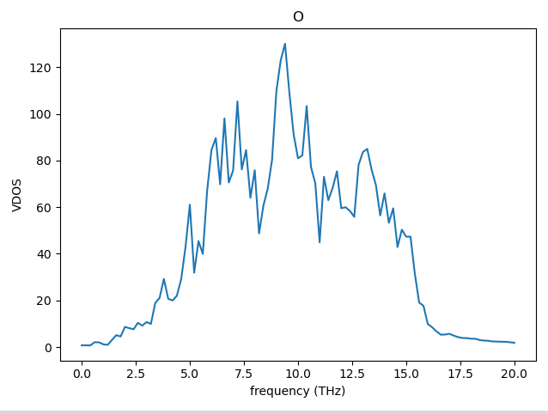
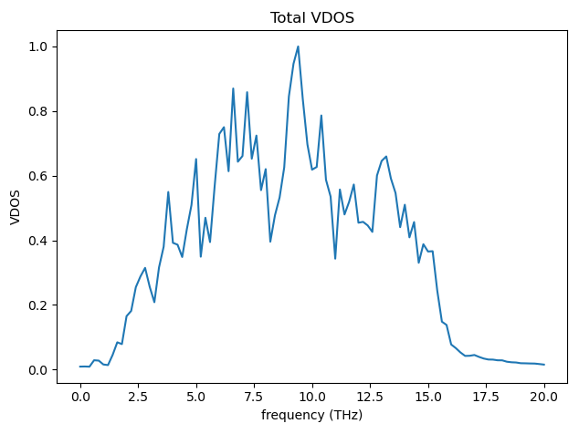
17 / 17

